Slide 1
Indigenous Constellations

Slide 2
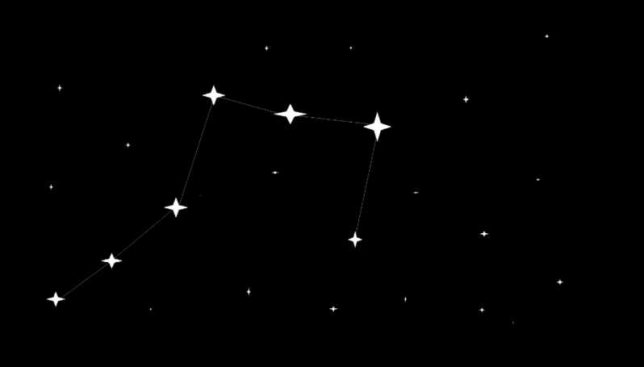
By the end of this lesson you should be able to:
1. | Describe what a constellation is.
2. | Explain how different constellations can be visible at different times of the year.
3. | Explain how constellations can be used for navigation.
4. | Describe how indigenous people used constellations.

Slide 3
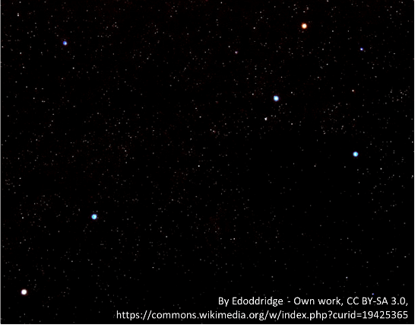
A constellation is a group of stars that form a recognisable pattern when viewed from Earth.
The constellation you are probably most familiar with is the Crux or Southern Cross - it's on the Australian flag!

Slide 4
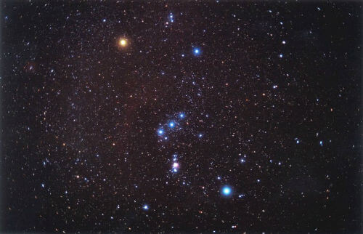
Because Earth is constantly moving, we also see different constellations at different times of the year.
For example, Orion is a constellation that is best seen from Australia in summer.

Slide 5
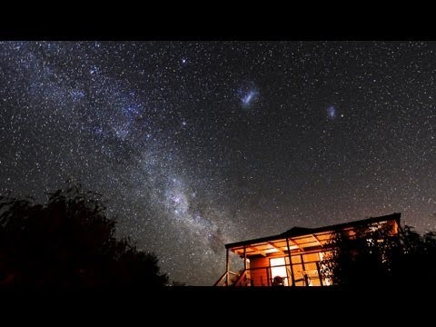

Slide 6
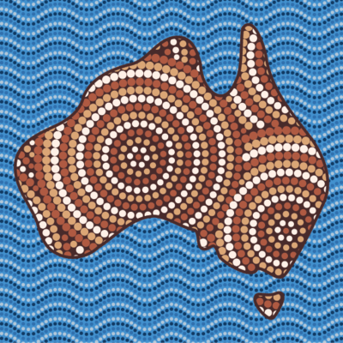
Australia can get very hot during the day, so it made sense for people to walk long distances at night when the temperatures were cooler.
Travelling at night meant the Indigenous people learnt how to use the stars and constellations to navigate.

Slide 7
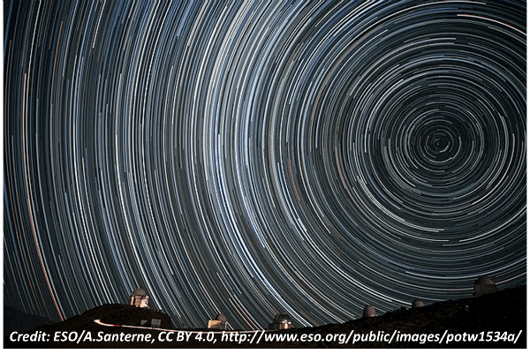
Since Earth rotates, if you take a timelapse of the sky over the course of a night you will see that the stars appear to rotate about a point.
This point is called the south celestial pole and is located above the south pole of Earth's axis of rotation.

Slide 8
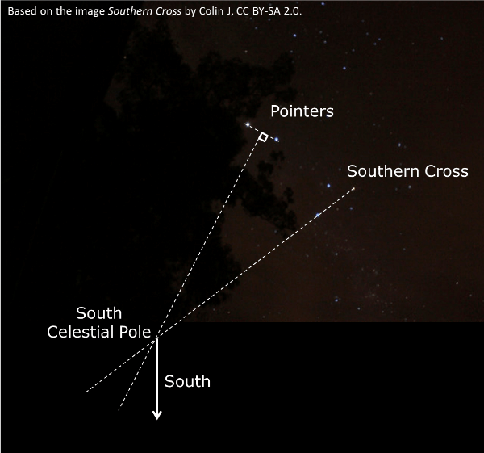
The Southern Cross is located very near to the south celestial pole, and you can use it to find south.
Next to the Southern Cross are two stars called the Pointers. First draw an imaginary line down the longest side of the Southern Cross to the ground. Then draw another imaginary line from the midpoint between the Pointers to the ground.
The point at which these two lines intersect is the south celestial pole. If you draw an imaginary line directly down to the ground from this point, you have found true south!

Slide 9
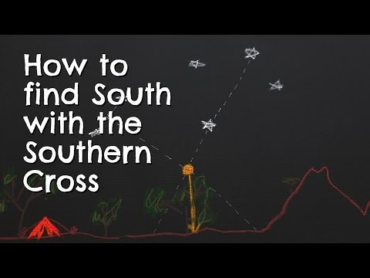

Slide 10
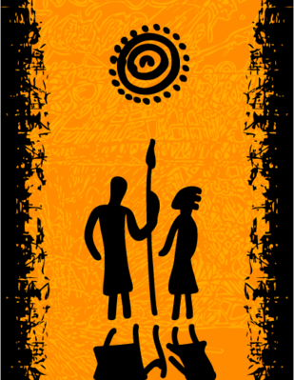
Indigenous people told stories about the constellations they could see.
For thousands of years, Indigenous Australian peoples have told stories about shapes they could see in the stars and passed these stories on through the generations.
Different tribes saw different shapes in the same stars and told different stories.

Slide 11
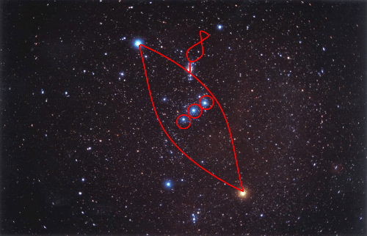
The Constellation Orion
The Yolngu people of Arnhem Land in the Northern Territory know the constellation Orion as a canoe, and it represents a reminder not to break the law.
The traditional Yolngu story tells how three brothers went fishing, and caught and ate a king-fish that was forbidden under their law. The Sun saw this and created a waterspout that carried them up into the sky, where you can still see them.

Slide 12
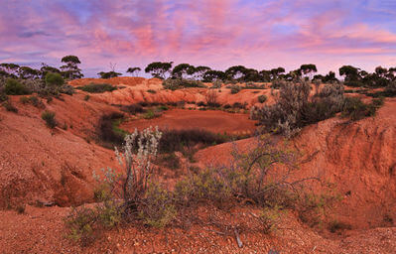
The three men in the canoe are collectively known as the constellation Djulpan.
Djulpan first appears in the sky during the early dry season, and the Yolngu people know that it is time to burn the grass and hunt for animals like goannas, wallabies and bandicoots.

Slide 13
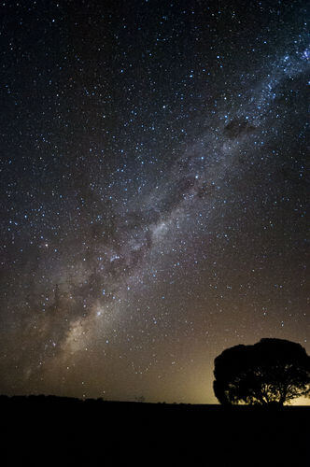
Many different Indigenous people groups feature a story of the Emu in the Sky.
The Emu is identified in the dark patches of the Milky Way galaxy. Indigenous Australian astronomy is rare in that they look at the dark patches in the sky, not just the stars to find patterns.

Slide 14
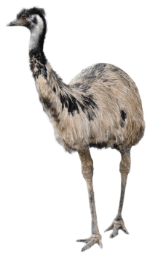
Different cultural groups have different stories about the Emu.
For example, the Kamilaroi people in northern New South Wales use the position of the Emu to indicate when is the best time to collect emu eggs.

Slide 15
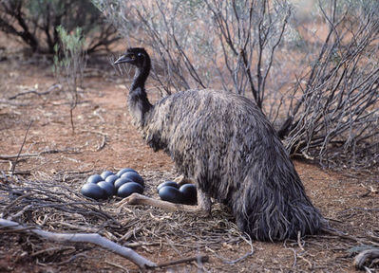
The Emu first becomes visible in March.
When it is fully visible in April and May it appears to be running, which represents the female emu chasing the male emu during mating season. This indicates is the right time to collect emu eggs.
In June and July, the legs disappear from the Emu which indicates the male emus are now sitting on the eggs. It is then too late to collect the eggs to eat.

Slide 16
